Slide 1


SCHOOL OF MANAGEMENT SCIENCES, LUCKNOW
Department of Computer Science & Engineering
“MAC Address Spoofing”
INTERNSHIP / MINI PROJECT ASSESMENT
Submitted By:
Vikash Yadav (2204230100089)
Internship Coordinator:
Mrs. Ayushi Patel
(Assistant Professor)

Slide 2
Introduction
MAC (Media Access Control) address spoofing is a technique used in ethical hacking where a device’s unique hardware identifier. This project explores the combined use of MAC Changer, a powerful open-source
SIEM (Security Information and Event Management) solution.
MAC Changer enables dynamic modification of Media Access Control (MAC) addresses in Kali Linux anomalies via system monitoring and inventory modules.

Slide 3

Objectives
Installing and Using MacChanger on Linux 🖥️
How to View and Change Your MAC Address
Using Random MAC Addresses for Anonymity 🔐
Restoring Your Original MAC Address
Troubleshooting Common Issues

Slide 4
Challenges
Based on the document "Implementing MAC Changer for Enhanced Network Security in Kali Linux", this
project addresses the following:
Key Challenges:
MAC address tracking used for surveillance.
MAC-based restrictions limiting legitimate access.
Gaps in compliance with privacy regulations (GDPR, HIPAA).

Slide 5
Features of the System
🔄 Change MAC address temporarily or permanently
🎲 Generate random MAC addresses for anonymity
🏷️ Mimic specific hardware vendors
🔍 Display current MAC and vendor info
🛠️ Restore original MAC address easily
🧩 Works with wired and wireless interfaces
🧪 Useful for privacy, testing, and bypassing filters
📜 Command-line based, script-friendly tool

Slide 6
Software and Hardware Requirements
Software:
Kali –Linux-2025.2-vmware-amd64 with macchanger
Hardware:
OS : Debian 10.x 64-bit
Version : Workstation 8.x virtual machine
RAM : 2GB

Slide 7
Methodology
Install macchanger
Identify Network Interface
Disable Interface Temporarily
Change MAC Address
Enable Interface Again
Verify Change

Slide 8
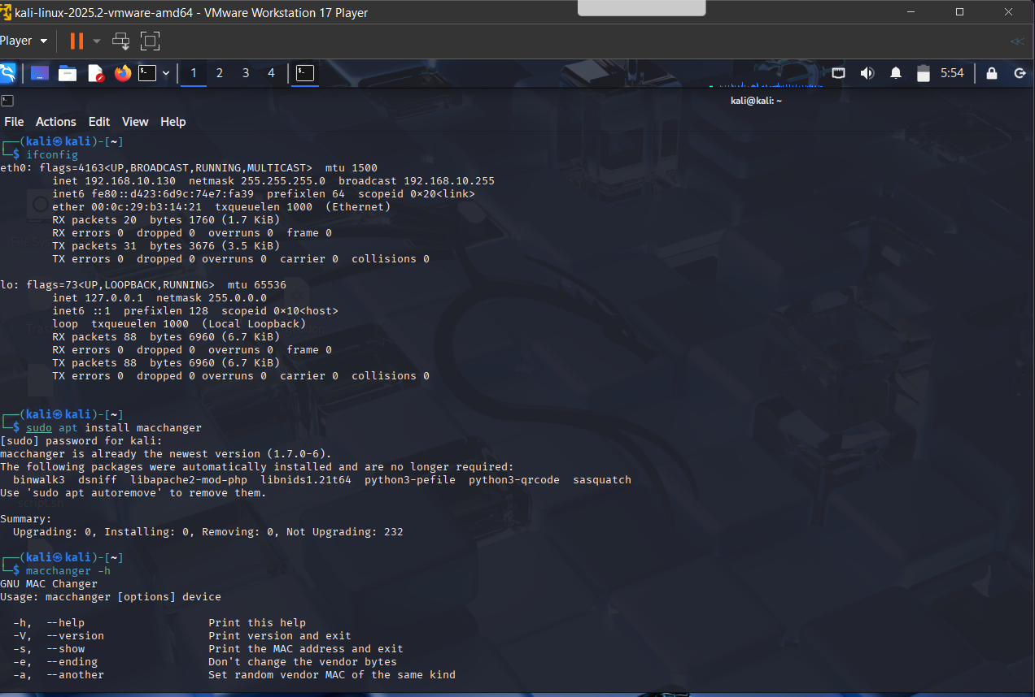

Slide 9
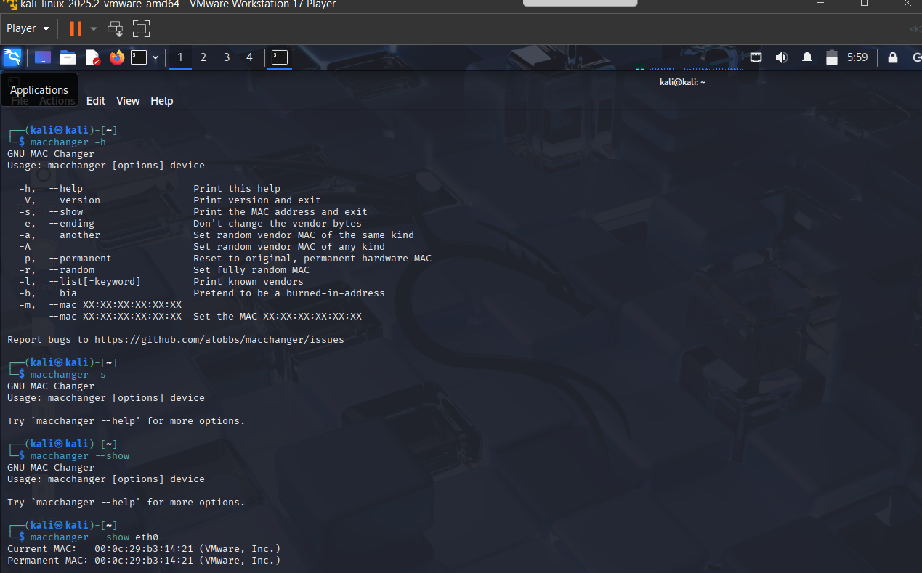

Slide 10
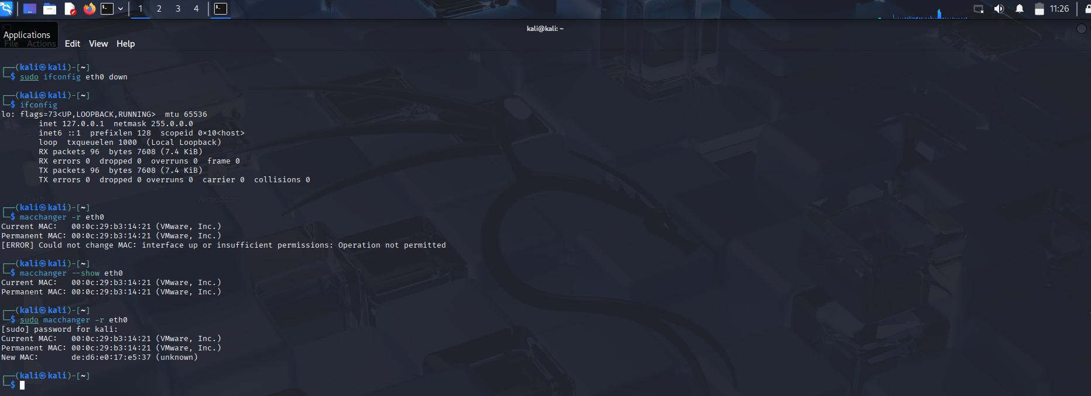

Slide 11
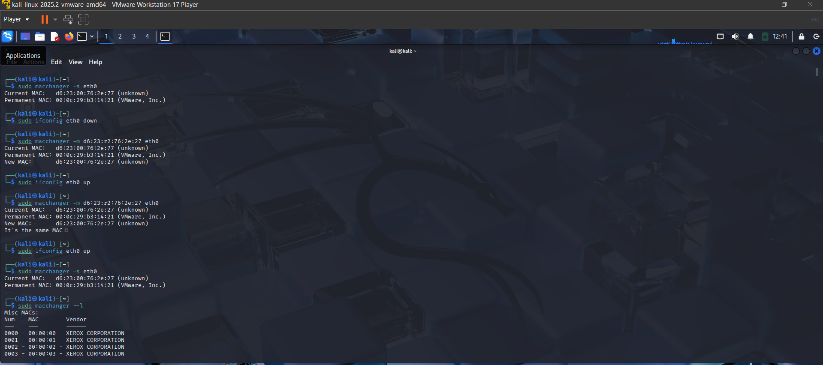

Slide 12
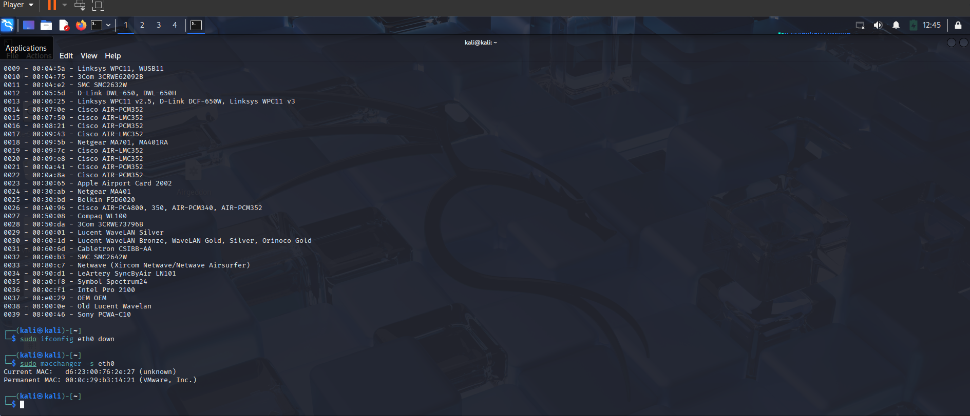

Slide 13
Results
Result of MAC Spoofing with macchanger
Successfully changes the device’s MAC address.
Helps bypass MAC-based filters or restrictions.
Enhances privacy by masking the original hardware identity.

Slide 14
Future Scope
Cybersecurity Training: Essential for ethical hacking and network defense education.
Privacy Protection: Increasingly relevant for users seeking anonymity on public networks.
IoT Testing: Useful for evaluating MAC-based access in smart devices.
Network Research: Helps study and improve MAC filtering and security protocols.

Slide 15
Conclusion
Changes the device’s MAC address temporarily or permanently
Enhances privacy by hiding the real hardware identity
Helps bypass MAC-based network restrictions and filters
Useful in ethical hacking and penetration testing
Supports cybersecurity research and IoT device testing
Must be used legally and responsibly

Slide 16
THANK YOU

